Slide 1
FINA 1303 THE SELL-SIDE: COMMERCIAL BANKS
Veronique Lafon-Vinais
Associate Professor of Business Education - Department of Finance

Slide 2
Course Map
Overview
Foundations of
Interest Rates
Financial Institutions
Pricing of Financial Assets
Regulations
DCF
Sell Side
Buy Side
Stock
Valuation
Banking Regulation
Basics of
Interest Rates
Commercial Banking
Traditional Institutional Investors
Asset
Pricing
Models
Monetary Policy
Investment Banking
Alternative Investors
2

Slide 3
Course map
Overview
Financial Institutions
What are Commercial Banks?
Bank Management
Types of Risk in Banking
Measuring Bank Performance
Current Issues
Sell Side
Commercial Banking

Slide 4
Banks as financial intermediaries
Bank
Saver/
Lender
$
Borrower
$
Deposit
Account
Loan
Contract
Asset transformation
Notes:
(US definition, source Mishkin)
Financial intermediaries are financial institutions that engage in financial asset transformation.
Financial intermediaries purchase one kind of financial asset from borrowers (generally a long term loan contract whose terms are adapted to the specific circumstances of the borrower) and sell a different kind of financial asset to savers, generally some kind of relatively liquid claim against the financial intermediary (eg deposit account).
Unlike brokers and dealers, financial intermediaries typically hold financial assets as part of an investment portfolio rather than as an inventory for resale.
In addition to making profits on their investment portfolios, financial intermediaries make profits by charging relatively high interest rates to borrowers and paying relative low interest rates to savers (margin income).
Types of financial intermediaries include:
depository institutions (commercial banks, savings and loans, mutual savings banks, credit unions)
Contractual savings institutions (life insurance companies, fire and casualty insurance companies, pension funds, government retirement funds)
Investment intermediaries (finance companies, stock and bonds mutual funds, money market mutual funds)

Slide 5
Commercial Banks
Financial Institutions
Financial Intermediaries
Depository Institutions
Commercial Banks
Retail Banking
Corporate & Investment Bank
Consumer Finance
Retail/Consumer
Banking
Wholesale
Banking
Trading, Treasury & Markets
Credit Cards
Private Banking/
Asset Management

Slide 6
Class discussion
What products and services do commercial banks offer to retail clients?
Who are the banks competitors?
What is the business model for retail banking v. wholesale banking?

Slide 7
Banking discussion: retail products & services
Lending
Deposits
Credit cards
Wealth management
Currency exchange
Insurance
Mortgage
Stock trading
Transfer services
Branches
Education services about finance
Checking and savings account
CDs
Utility functions: safe deposit boxes; travelers checks
ATM
Advisory services for investments
Customers include SMEs

Slide 8
Banking discussion: bank competitors
Fast lending services
Crypto currencies
Fintech companies: Paypal, Square (banks are too slow)
Online B2B platforms
Online companies like Alipay in China, Ant Financial
Retailers like Starbucks
Start ups providing solutions for SMEs to consolidate credit
Finance companies like UA
Financial companies that provide substitute to deposits
All companies that provide installment loans
Securities companies (apps for stock trading)
Companies offering their own credit cards
Investment banks
Credit unions
Corporates have investment banking/corporate finance
Government departments?
Buy Now Pay Later

Slide 9
Banking discussion: retail v. wholesale banking
Customers are different: individual v. companies, large corporates, governments
Different size of transactions
Interest rate based for retail; fee based for wholesale
Using deposits for corporate lending
Brokerage services
Wholesale much bigger scale; retail give loans to individuals
Different objectives
Can offer discount based on scale
Different value proposition: convenience, more dispersed services (retail)
Higher customer intimacy – customer relationship (wholesale)
Corporate finance advice (wholesale)
Collaborate with other banks
High origination costs

Slide 10
Commercial Banking
Retail banking
Wholesale banking
Clients = Retail (individuals)
Provide residential and consumer loans
Accepting small deposits
Clients = Corporates and Institutionals (large size → wholesale)
Provide commercial and industrial loans
Funded with deposits and purchased funds

Slide 11
Mortgages in HK: what types of mortgages do banks offer? What are typical terms? Could we have a subprime crisis in HK?
Group 1
Video
https://www.youtube.com/watch?v=cP7IjoeMcZw
Article
https://www.moneyhero.com.hk/blog/en/mortgage-lesson-4-types-of-mortgages-in-hk#:~:text=Mortgage%20plans%20in%20Hong%20Kong,(3)%20Deposit%2Dlinked

Slide 12
Forces shaping International Banking
Changes in the structure of banking
New entrants
Globalization
Reduction in profit margins
Disintermediation
Technological changes
Increased competition
Ongoing product & process innovation
Innovation
Transformation of regulatory framework
Regulation/
Deregulation

Slide 13
Commercial Banks
Traditional products and services:
New products and services
Deposit accounts
Credit services
Payment and collection services
Trade services
FX services
Credit enhancement or payment guaranty
Agent or fiduciary services
Investment banking services
Consulting services
Risk management services
Broker/dealer services
Insurance services
Asset management
Notes:
Deposit accounts - 2 basic types:
Demand deposit accounts (DDAs) (also known as checking accounts) = a method by which an account holder uses a financial institution to transfer funds to a third party
Time deposit accounts. Time deposits must be held at a bank, thrift or credit union for a specified period. They include:
CDs = negotiable or non-negotiable obligations of a bank offered at either fixed or variable interest rates. Sold to individuals or companies, maturities 7 days to several years
Negotiable CDs = generally sold in blocks of $1 million to companies, MM funds and other large investors. Maturities 14 days to 5 years
Retail CDs = non-negotiable CDs sold to individual investors in amounts varying from institution to institution, maturities 3 months to 5 years
Savings accounts or passbook accounts = accounts that pay interest on balances
Other interest-bearing accounts, for example accounts that have some features of both demand and time deposit accounts e.g.
Money market deposit accounts = accounts that pay an unregulated rate of interest determined by the bank and allow limited check writing transfers and electronic withdrawals
NOW (Negotiable Order of Withdrawal) accounts = offer unlimited check writing and pay unregulated rates of interest. Available only to individuals, sole proprietorships, not-for-profit orgs and government entities

Slide 14
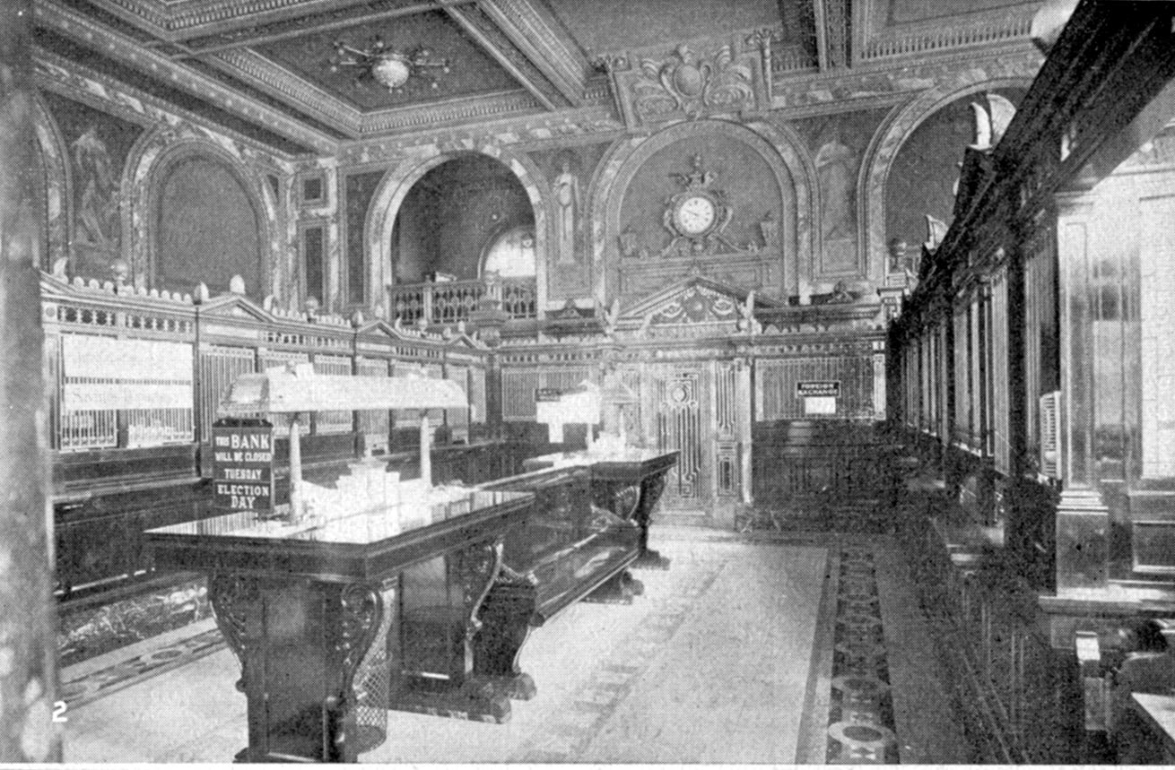
Banks in the old days

Slide 15

Banks today

Slide 16
Multiple Role of Banks
Borrower
Lender
Liquidity
Providers
Banks
Payment
Channel
Credit
Enhancement
Custody Agents
Conduit for
Monetary Policy
Trustees

Slide 17
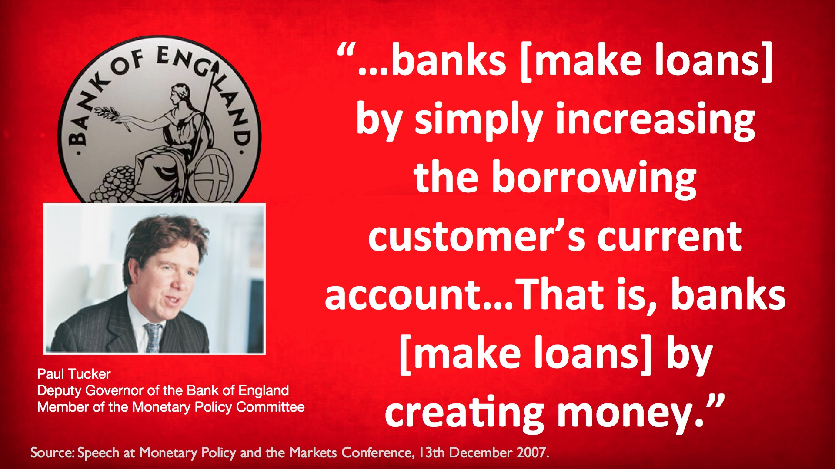
The very special role of banks: money creation

Slide 18

Money creation: how it works
The loan is an asset for the bank
The deposit is a liability for the bank
The bank makes a loan to the business
The bank deposits the money from the loan into a deposit account for the business
Bank deposits are part of the money supply

Slide 19
Banks in Hong Kong: digital banking developments and implications
Group 2
Video
https://drive.google.com/file/d/10q84pxiGauRLVrAv2oVCBGiKpyY-7ScK/view
Article
https://blog.startupr.hk/virtual-banking-in-hong-kong/

Slide 20
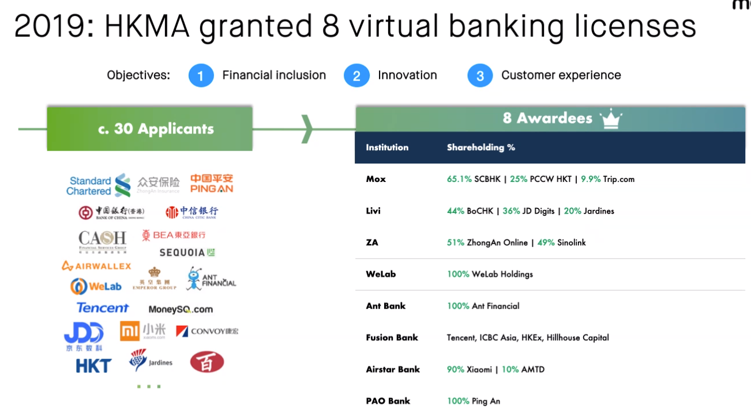
Source: Mox FCCIHK presentation 2 Feb 21
Notes:
Source: Mox FCCIHK presentation 2 Feb 21 by Edwin Hui

Slide 21
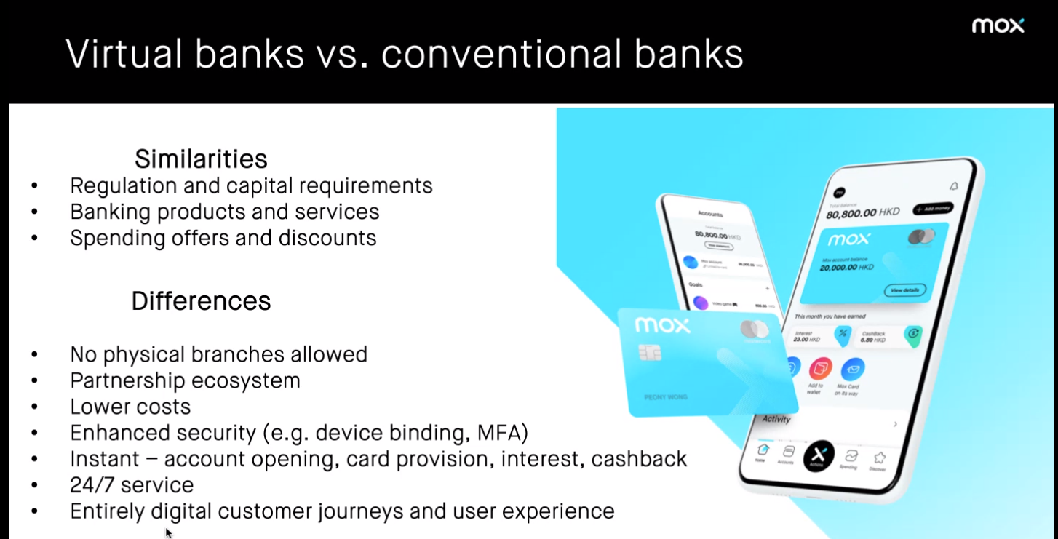
Source: Mox FCCIHK presentation 2 Feb 21
Notes:
Source: Mox FCCIHK presentation 2 Feb 21 by Edwin Hui

Slide 22
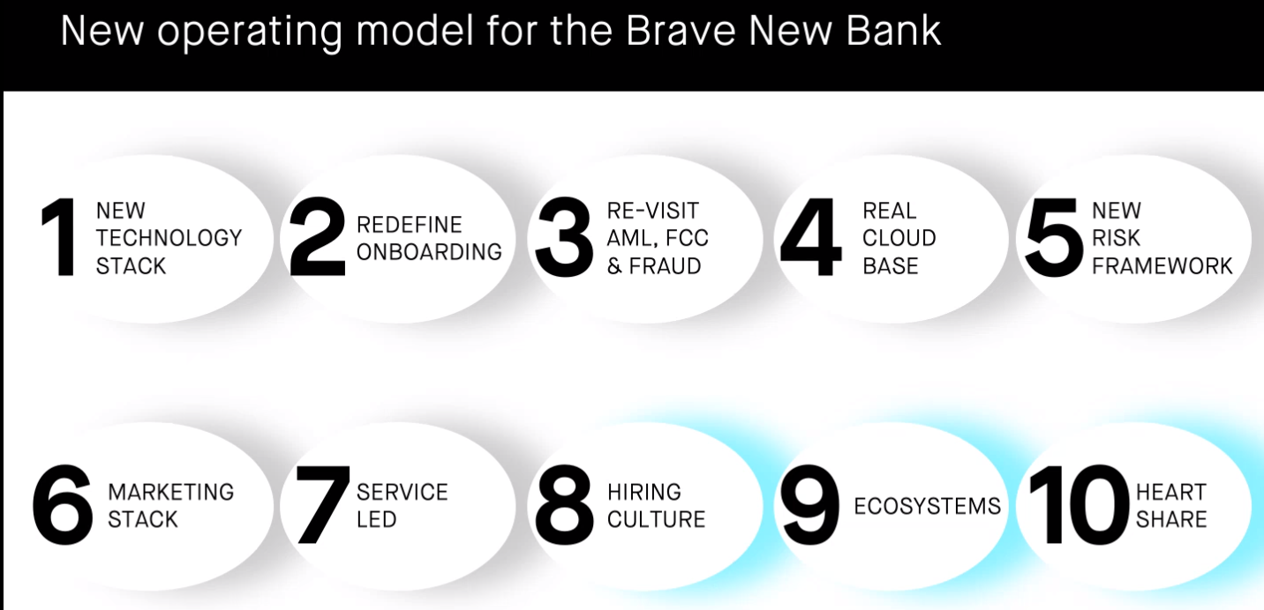
Source: Mox FCCIHK presentation 2 Feb 21
Notes:
Source: Mox FCCIHK presentation 2 Feb 21 by Edwin Hui

Slide 23
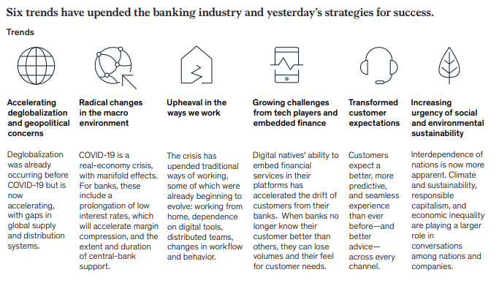
Trends in banking industry
Source: McKinsey Global Banking report 2020
Notes:
Source: McKinsey Global Banking report 2020 https://www.mckinsey.com/industries/financial-services/our-insights/global-banking-annual-review

Slide 24
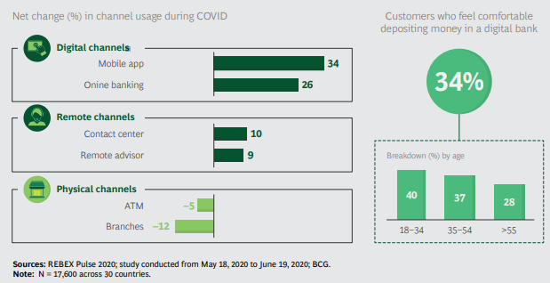
Customers are increasingly turning to digital banking
Source: BCG Dec 2020
Notes:
Source: BCG Dec 2020 https://web-assets.bcg.com/33/41/c8a334f74926921d5aa9296ea6cc/bcg-the-sun-is-setting-on-traditional-banking-nov-2020.pdf

Slide 25
Banks in China: will digital banking replace traditional banking?
Group 3
Video
https://www.youtube.com/watch?v=s4tSP9-o7ZQ
Article
https://www.ft.com/content/196cfd50-46d9-11e7-8d27-59b4dd6296b8

Slide 26
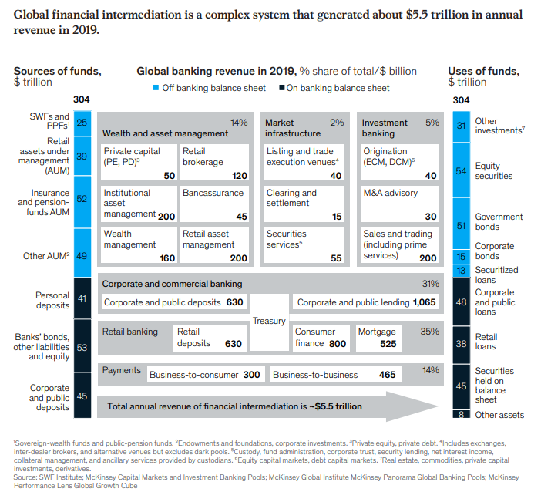
Global Financial Intermediation
Source: McKinsey Global Banking report 2020
Notes:
Source: McKinsey Global Banking report 2020 https://www.mckinsey.com/industries/financial-services/our-insights/global-banking-annual-review

Slide 27
SUMMARY (KLOs)
What are commercial banks
What they do (basic business models)
Competitors
Money creation

Slide 28
Course map
Overview
Financial Institutions
What are Commercial Banks?
Bank Management
Types of Risk in Banking
Measuring Bank Performance
Current Issues
Sell Side
Commercial Banking

Slide 29

Class discussion
Imagine that you are the CEO of a large bank
(pick one and name it)
What keeps you awake at night and why?

Slide 30
Bank Management
4 primary concerns of bank managers: | Aspects of bank management:
Make sure bank has enough cash to pay deposit outflows | Liquidity management
Pursue an acceptably low level of risk by acquiring assets with low default rate and diversifying asset holdings | Asset management
Acquire funds at low cost | Liability management
Decide the amount of capital the bank should maintain and acquire this capital | Capital management
ALM
Notes:
3 major aspects of bank management:
Liquidity Management (management of reserves so the bank stays liquid to meet deposit outflows)
ALM i.e. Assets and Liabilities Management (management of balance sheet for profits i.e. cheap sources of funds and high income producing assets)
Capital Management (management of solvency): Bank capital prevents bank failure; necessity to maintain balance between high capital (high solvency) and low capital (higher return to shareholders measured by ROE Return on Equity = Net Profits over Equity Capital). More refined way would be RAROC (Risk Adjusted Return on Capital)

Slide 31
Liquidity Management Scenario 1
Bank A (Reserve Requirement = 10% of Deposits)
Assets |  | Liabilities
Reserves | $20 mil | Deposits | $100 mil
Loans | $80 mil | Capital | $10 mil
Securities | $10 mil
Reserve req.
= $10 mil
Excess reserves
= $10 mil
Deposit outflow of $10 mil
Bank A (Reserve Requirement = 10% of Deposits)
Assets |  | Liabilities
Reserves | $10 mil | Deposits | $90 mil
Loans | $80 mil | Capital | $10 mil
Securities | $10 mil
Reserve req.
= $9 mil
Excess reserves
= $1 mil
Notes:
Liquidity Management : When bank receives deposits, reserves ↑ by equal amount; when bank loses deposits, reserves ↓ by equal amount.
Assume that bank has to keep 10% of total deposits as required reserves. In this case Bank A has reserves of $20 million therefore it has excess reserves of $10 million.
Question to Students: What is liquidity risk?
Answer: The risk that a bank may not be able to fund increases in assets or meet obligations as they fall due without incurring unacceptable losses.
Question to Students: why is liquidity management extremely important?
Answer: Because lack of liquidity can trigger bank run.
10% reserve requirement is applied to total amount of deposits in this case 10% of 100 million is 10 million
If a bank has ample reserves a deposit outflow does not necessitate changes in other parts of its balance sheet

Slide 32
Liquidity Management Scenario 2
Bank B (Reserve Requirement = 10% of Deposits)
Assets |  | Liabilities
Reserves | $10 mil | Deposits | $100 mil
Loans | $90 mil | Capital | $10 mil
Securities | $10 mil
Reserve req.
= $10 mil
Excess reserves
= none
Deposit outflow of $10 mil
Bank B (Reserve Requirement = 10% of Deposits)
Assets |  | Liabilities
Reserves | $0 mil | Deposits | $90 mil
Loans | $90 mil | Capital | $10 mil
Securities | $10 mil
Reserve req.
= $9 mil
Shortfall of res.
= $9 mil

Slide 33
Liquidity Management 4 Possible actions for Bank B
Borrow from other banks or corporations
Sell securities
Assets |  | Liabilities
Reserves | $9 mil | Deposits | $90 mil
Loans | $90 mil | Capital | $10 mil
Securities | $10 mil | Borrowings | $9 mil
Assets |  | Liabilities
Reserves | $9 mil | Deposits | $90 mil
Loans | $90 mil | Capital | $10 mil
Securities | $1 mil
Source: Mishkin/Eakins
Notes:
The bank can acquire reserves by borrowing from other banks in the fed funds market or borrowing from corporations by issuing CDs or CP.
It can sell of its securities to cover the deposit outflow; however some securities may be illiquid, and there will be brokerage and other transactions costs

Slide 34
Liquidity Management 4 Possible actions for Bank B (Cont)
Borrow from the FED
Call in or sell off loans
Assets |  | Liabilities
Reserves | $9 mil | Deposits | $90 mil
Loans | $90 mil | Capital | $10 mil
Securities | $10 mil | Discount loans | $9 mil
Assets |  | Liabilities
Reserves | $9 mil | Deposits | $90 mil
Loans | $81 mil | Capital | $10 mil
Securities | $10 mil
Source: Mishkin/Eakins
Notes:
The bank can borrow from the Fed at the discount window – it will pay the discount rate, which is set by the Fed and is normally higher than interbank rates
It can also sell some of its loans
Conclusion: excess reserves are insurance against above 4 costs from deposit outflows
Calling in loans = not renewing them when they come due
Selling off loans = secondary sale of loans

Slide 35
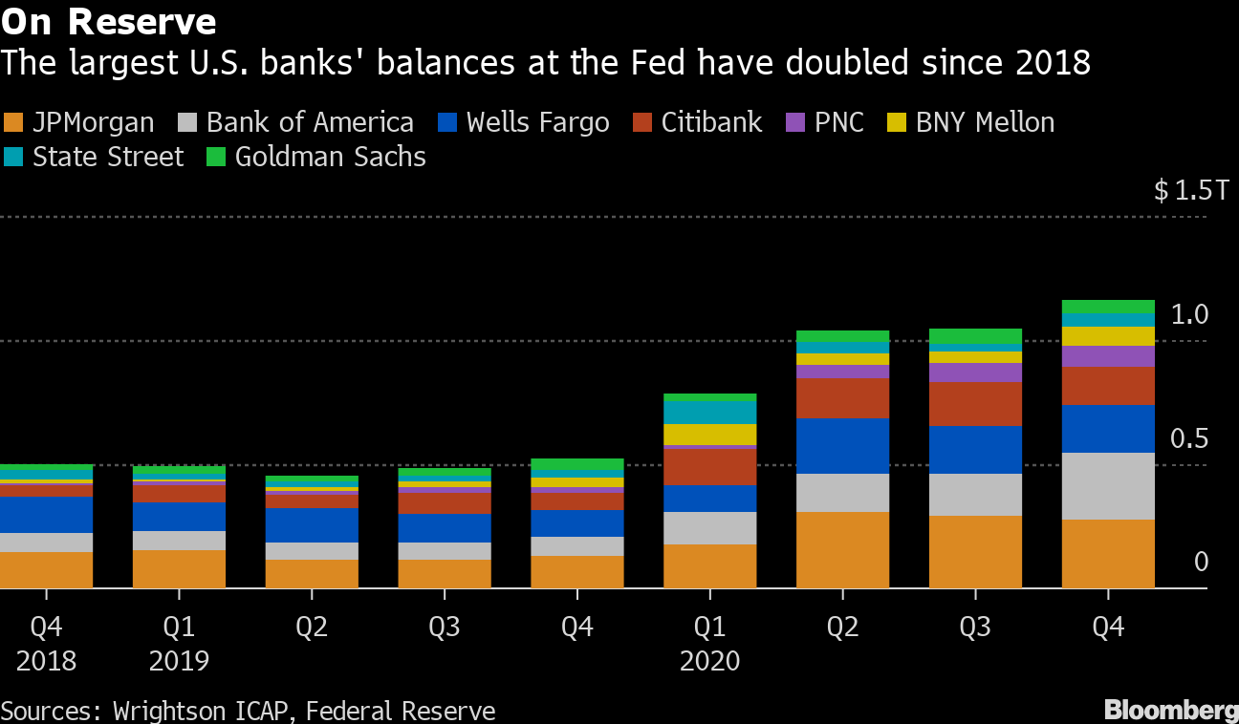
Reserves
Source: Bloomberg 15 March 21
Notes:
Source: Bloomberg 15 March 21 https://mail.google.com/mail/u/0/#inbox/WhctKJWQjnCLMlpqRJVHNpdTHDtZZzgqHfGfcdrDkQJLZhzKVrwwCqlBSWpgPrDBVzVSfqB?projector=1
Supplementary leverage ratio (SLR)
The supplementary leverage ratio is the US implementation of the Basel III Tier 1 leverage ratio, with which banks calculate the amount of common equity capital they must hold relative to their total leverage exposure. Large US banks must hold 3%. Top-tier bank holding companies must also hold an extra 2% buffer, for a total of 5%. The SLR, which does not distinguish between assets based on risk, is conceived as a backstop to risk-weighted capital requirements.

Slide 36
ALM: Asset and Liability Management
Asset Management
Get borrowers with low default risk, paying high interest rates
Buy securities with high return, low risk
Diversify portfolio
Manage liquidity by holding liquid assets and managing reserves
Liability Management
No longer primarily depend on deposits
When see loan opportunities, borrow or issue CDs to acquire funds
Notes:
To maximize its profit, a bank must simultaneously seek the highest returns possible on loans and securities, reduce risk, and make provisions for liquidity by holding liquid assets.
ALM : Diversification of
Asset portfolio (shoot for high returns and low risks) and
Sources of funds
(Decrease in cheap deposits as source of funds for banks since the 60s  new ways to fund business includes borrowings i.e. CDs, CP, etc…). One measure of bank profitability is ROA (Return on Assets = net profits over total assets).
Before the 1960s, over 60% of the sources of funds of the banks were obtained through checkable (demand) deposits that by law could not pay interest => cheap funding cost for banks. Banks could not compete for the deposits so their amount was a given for any individual bank. Also the interbank market was not well developed.
Starting in the 60s, large money center banks in key financial sectors (NY, Chicago, SF) began to explore ways in which the liabilities on their balance sheets could provide them with reserves and liquidity  development of the o/n interbank market (fed funds) and money market instruments such as CDs  shift of emphasis on liability management as a way to fuel expansion and growth.

Slide 37
Off-Balance-Sheet Activities
Fee income from:
Foreign exchange trades for customers
Servicing mortgage-backed securities
Guarantees of debt
Backup lines of credit
Trading in and of:
Financial futures and options
Foreign exchange
Interest rate swaps
Loan sales
Off-balance sheet activities involve trading financial instruments and generating income from fees and loan sales, activities that affect bank profits but do not appear on bank balance sheets
(source: Mishkin)
Contingent
liabilities
All these activities involve RISK
Notes:
Loan sales = asset sales = secondary loans involves a contract to sell all or part of a cash stream from a specific loan and removes the loan from the balance sheet.
Off balance sheet activities involving guarantees of securities and backup credit lines increase the risk a bank faces. Even though a guaranteed security does not appear on a bank’s balance sheet, it still exposes the bank to default risk and if the issuer of the security defaults, the bank if left holding the bag and must pay the security owner.. Back up credit lines also expose the bank to risk because the bank may be forced to provide loans when it does not have sufficient liquidity or when the borrower is a poor credit risk.
Banks attempts to manage IR risk led them to trading in financial futures, options for debt instruments and interest rate swaps. They also engaged in FX trading. All transactions in these markets are off balance sheet because they do not have a direct effect on the bank’s balance sheet.

Slide 38
Capital Adequacy Management
Tradeoff between safety (high capital) and return (ROE)
Banks also hold capital to meet capital requirements
Strategies for Managing Capital
Sell or retire stock
Change dividends to change retained earnings
Change asset growth (increase or shrink balance sheet by acquiring or selling off assets)
Source: Mishkin/Eakins
Notes:
Bank capital benefits the owners in that it makes their investment safer by reducing the likelihood of bankruptcy; but it is costly because the higher the amount of capital, the lower the return on equity for a given return on assets => in determining the amount of capital, bank managers have to decide how much safety they are willing to trade off against return.
Banks hold capital because they are required to do so by regulatory authorities. Generally bank management want to hold less capital than required by authorities due to cost of capital.
Banks experiencing capital shortfalls who are not able to issue new stock or reduce dividends will shrink their balance sheet by selling off assets (eg FNBC in 1984)

Slide 39

Test Your Understanding
What is the theoretical background for capital adequacy requirements
More capital increases cushion for losses
More capital provides incentive for shareholders to monitor management
None of the above
All of the above

Slide 40
SUMMARY (KLOs)
Understand the key aspects of bank management
Liquidity risk and how to manage it
Role of off-balance sheet activities

Slide 41
Course map
Overview
Financial Institutions
What are Commercial Banks?
Bank Management
Types of Risk in Banking
Measuring Bank Performance
Current Issues
Sell Side
Commercial Banking

Slide 42
Risk Management Basics
Identify
1) Eliminate
2) Keep
3) Mitigate
4) Increase
Quantify
Manage
1) Probability
2) Severity
Verify

Slide 43

Types of Risk in Banking
Credit
Liquidity
Market
Operational
Legal & Reputational
Notes:
Credit risk arises from potential that a borrower or a counterparty to a transaction will fail to perform an obligation
Liquidity risk is the potential that an institution will be unable to meet its obligations as they come due because of an inability to liquidate assets or obtain adequate funding (funding liquidity risk) or that it cannot easily unwind or offset specific exposures without significantly lowering market prices because of inadequate market depth or market disruptions (market liquidity risk)
Market risk is the risk to a financial institution’s condition resulting from adverse movement in market rates or prices, such as interest rates, foreign exchange rates or equity prices
Operational risk arises from the potential that inadequate information systems, operational problems, breaches in internal controls, fraud or unforeseen catastrophes will result in unexpected losses
Legal risk arises from the potential that unenforceable contracts, lawsuits, or adverse judgments can disrupt or otherwise negatively affect the operations or condition of a banking organization
Reputational risk is the potential that negative publicity regarding an institution’s business practices, whether true or not, will cause a decline in the customer base, costly litigation, or revenue reductions.

Slide 44

Credit risk
The ability and willingness of a borrower to pay when due
Components: default risk and recovery risk
Within a given level of default risk, recovery risk can vary widely
Recovery highly dependent on position in capital structure e.g. higher recovery for secured debt and on type of issue e.g. recovery higher for loans than bonds
Remedy: liquidate or work-out?

Slide 45
Credit Risk
Types
Mitigation
Borrower
Counterparty
Country
Industry
Consumer
Settlement risk
Credit policy
Credit limits
Concentration limits
Credit scoring
Netting
Credit bureau
Ratings
Notes:
Settlement risk is the risk of loss due to a counterparty’s failure to perform on its obligations after an institution has performed on its obligations under a contract on a settlement date. Settlement risk frequently arises in international transactions due to time zone differences. This risk is only present in transactions that do not involve DVP and generally exists only for a short time.

Slide 46
Credit risk in Asia: what is the level of NPLs (non performing loans) for banks in Asia? How has it evolved over time? Implications?
Group 4
Video
https://www.bloomberg.com/news/videos/2020-02-27/buying-non-performing-loans-in-southeast-asia-arena-management-says-video
Article
https://www.spglobal.com/ratings/en/research/articles/200406-for-asia-pacific-banks-covid-19-crisis-could-add-us-300-billion-to-credit-costs-11359063

Slide 47
Market risk
Types
Mitigation
Interest Rate risk
FX risk
Equity risk
Commodity risk
ALM policy
Hedging
Risk management policy and limits

Slide 48
Liquidity Risk
Types
Mitigation
Funding liquidity risk
Market liquidity risk
ALM policy
Conservative funding policy
Conservative ratios
“Liquidity is an illusion. It’s always here when you don’t need it, and rarely there when you do”
Michael Milken
Notes:
Liquidity risk is the risk of loss due to failure of an institution to meet its funding requirements or to execute a transaction at a reasonable price.
Market liquidity risk is the risk that an institution may not be able to exit or offset positions quickly, and in sufficient quantities, at a reasonable price. This inability may be due to inadequate market depth in certain products, market disruption, or inability of the bank to access the market (eg downgrading of the institution or major counterparty)
Funding liquidity risk is the potential inability of the institution to meet funding requirements because of cash flow mismatches, at a reasonable cost. With respect to derivatives, such funding requirements may arise from cash flow mismatches in swap books, exercise of options, implementation of dynamic hedging strategies.

Slide 49
Operational Risk
Types
Mitigation
Inadequate information systems
Operational breakdown
Breaches in internal control
IT security breakdown
Unforeseen catastrophes
Fraud
Risk management policy
Back up and recovery plans
Segregation of duties
Outsourcing
Audits
“West LB’s equity trading loss soars; trading investigation launched”
FT 31 August 07
“Jail for ex-NAB rogue forex dealers”
FT 5 July 06
Notes:
Operational risk is the risk of loss occurring as a result of inadequate systems and control, deficiencies in information systems, human error or management failure.

Slide 50
Operational risks in banks in Asia: find recent incidents, what happened, consequences
Group 6
Video link
https://www.youtube.com/watch?v=2WV3sIcWNxE
Article
https://finance.yahoo.com/news/hong-kong-slaps-record-fine-093000692.html

Slide 51
Legal & Reputational Risks
Types
Mitigation
Regulatory risk
Money Laundering
Conflicts of Interest
Non-enforceability of contracts
Non-compliance with corporate governance laws
SEE issues
Implement SOX and related corporate governance policies
KYC Policies
Legal & Compliance Dpts reporting to CEO
Audits
SEE audits (environmental and corporate governance)
Notes:
Legal risk is the risk of loss arising from contracts which are not legally enforceable (eg the counterparty does not have the power or authority to enter into a particular type of transaction) or documented correctly
Regulatory risk is the risk of loss arising from failure to comply with regulatory or legal requirements
Reputation risk is the risk of loss arising from adverse public opinion and damage to reputation

Slide 52
Reputational Risk for Financial Institutions: do we care? Examples in Asia
Group 7
Video
https://www.youtube.com/watch?v=G40P66-vTDI
Article
https://www.jocpr.com/articles/research-on-reputation-risk-management-of-commercial-banks-in-china.pdf

Slide 53
Test Your Understanding
What is recovery risk?
The risk of the borrower not paying
The risk of how much the lender can recover in a case of default
How do banks help prevent money laundering (which type of policy?)
ALM policy
KYC policy
Credit policy

Slide 54
SUMMARY (KLOs)
Basics of Risk Management
Credit risk dimensions and mitigation
Understanding market risk
Market risk mitigation strategies
Understanding operational risk
Operational risk mitigation strategies
Understanding legal & reputational risk and mitigation strategies

Slide 55
Course map
Overview
Financial Institutions
What are Commercial Banks?
Bank Management
Types of Risk in Banking
Measuring Bank Performance
Current Issues
Sell Side
Commercial Banking

Slide 56
Measuring Bank Performance
Income statement
Operating Income: the income that comes from a bank’s ongoing operations =
Interest income = interest on the bank’s assets
Non-interest income = service charges and fees, plus revenues from off-balance sheet activities
Operating Expenses : expenses incurred in conducting the bank’s ongoing operations =
Interest expense = interest on bank’s liabilities
Non-Interest expense = operational costs e.g. wages
Provision for loan losses
Net Operating Income (NOI)
Source: Mishkin/Eakins
Notes:
When a bank has a bad debt or anticipates that a loan might become a bad debt in the future it can write up the loss as a current expense in its income statement under the provision for loan losses. This is directly related to the loan loss reserves because when a bank wants to increase its loan loss reserve account it does so by increasing the provision for loan losses. By increasing expenses when losses have not yet occurred, earnings are being set aside to deal with losses in the future.
Net operating income is closely watched as an indicator of how well bank is doing on ongoing basis.
Net income before taxes or profit before taxes is the NOI adjusted for gains/losses on securities sold and net extraordinary items.

Slide 57
Key Indicators
Profitability | Size & Market Share | Other Financial | Other
Operating income Net income EPS ROA ROE ROEC RAROC Customer profitability | Total Assets Market Cap Funds under management League Tables Volume estimations | VAR Share Price Ratings | Awards Customer satisfaction Employee turnover Lawsuits
Notes:
Measures of bank performance:
Net profit (ROA)
Operational income
ROE (Return on Equity)
ROAC (Return on Adjusted Capital)
ROCE (Return on Capital Employed)
RAROC (Risk Adjusted Return on Capital)
Additional tools of bank management:
LOB profitability and VAR
Customer profitability
Importance of looking at the numbers on a historic comparison basis as well as industry basis (ratios don’t mean anything on an absolute basis)  see trends

Slide 58
Key Constituencies
Rating Agencies
Regulators
Suppliers
Management
Shareholders
Creditors
Employees
Competitors
Customers

Slide 59
Bank Organization
Matrix management
Lines of business/lines of products
CRM and implications
Shifting strategies
Impact of bank mergers
Impact of bank regulation/deregulation

Slide 60
Matrix Management
Markets
 | US | EMEA | ASPAC | LATAM
FX
MM
DCM
ECM
Derivatives
M&A
LOB
Notes:
This is a basic matrix with geographies and products; nowadays evolving to customer centric models, can be tri-dimensional matrices with customer segments/markets/lines of business. Reporting lines become increasingly complex, with some specialists having multiple hierarchical reporting lines.

Slide 61
Derivatives in Asia: what is the level of development of derivatives market (on exchange and OTC) across Asia? What about China? What are the issues? Implications?
Group 5
Video
https://www.cnbc.com/video/2020/05/19/70percent-to-80percent-of-asia-investors-trades-are-in-derivatives-td-ameritrade.html
Article
https://www.institutionalinvestor.com/article/b18jf346frjd1v/the-growing-influence-of-asia-in-derivatives-trading

Slide 62
SUMMARY (KLOs)
Understanding the various types of performance indicators
Understanding matrix management

Slide 63
Course map
Overview
Financial Institutions
What are Commercial Banks?
Bank Management
Types of Risk in Banking
Measuring Bank Performance
Current Issues
Sell Side
Commercial Banking

Slide 64
Current issues in banking
Regulatory pressure
New entrants
Technology/FinTech
Shadow banking

